Slide 1
TIDY UP!
DOES YOUR
SPARK JOY?
Sharon Hawkins
ARDOT – GIS and Mapping
Notes:
I’m sure that some of you are familiar with the Japanese author, Marie Kondo, and her take on the art of organizing, purging, and fully considering what you have and what you need. I thought that those principles would make for an exciting presentation title, because let’s face it….

Slide 2
Talking about data isn’t always exciting…

Slide 3
IDENTIFIED CHALLENGES WITH DATA
Communication
Data Accessibility
Data Documentation
Duplication of Effort
Data Standards

Slide 4
IDENTIFIED CHALLENGES
EXAMPLE
County
CO
AHTD_COUNTY
COUNTYNUMBER
County_Num
AH_County
Route
RTE
ROUTENUM
ROUTE
Road
AH_Route
Sectn
SEC
sectn
SECTON
Section
AH_Section
COUNTY
Communication
ROUTE
Data Documentation
SECTION
Duplication of Effort
Data Standards

Slide 5
IDENTIFIED CHALLENGES
HEAD
CHEF
HEAD
CHEF
HEAD
CHEF
HEAD
CHEF
HEAD
CHEF

Slide 6
IDENTIFIED CHALLENGES

Slide 7
A DIFFERENT APPROACH
December 2016
DATA BUSINESS PLAN
Develop a plan for ARDOT to meet current and future business needs for data
Comply with state and federal requirements
Improve organization, collaboration, collection, analysis and reporting of data

Slide 8
FROM THE OUTSIDE LOOKING IN

Slide 9
MISSION: DEVELOP AN ACTIONABLE
ROADMAP TO IMPROVE DATA AT AN
ENTERPRISE LEVEL
Implement Data Governance
at an Enterprise (Department)
level
Advertise to and train
data users
Examine, create, and revise
policies and documentation
Assess the current state of
data at ARDOT

Slide 10
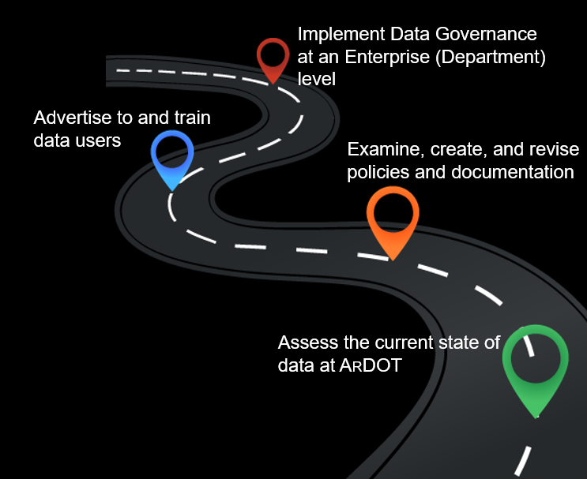
ASSESS CURRENT STATE - SURVEY SAYS!
APRIL 2017
233 Completed Responses Received

Slide 11
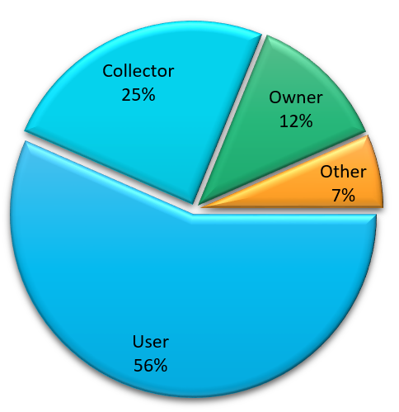
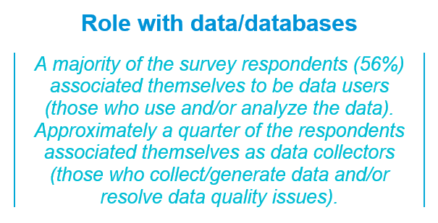
ASSESS CURRENT STATE - SURVEY SAYS!

Slide 12
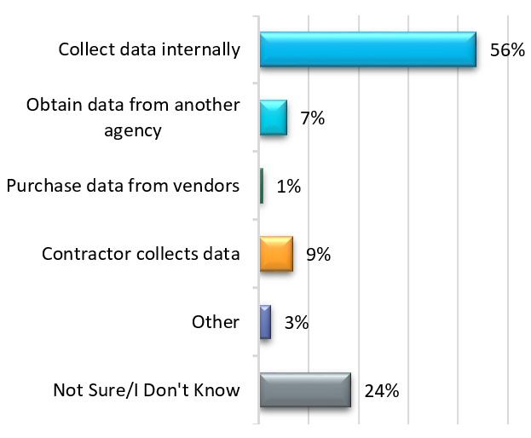
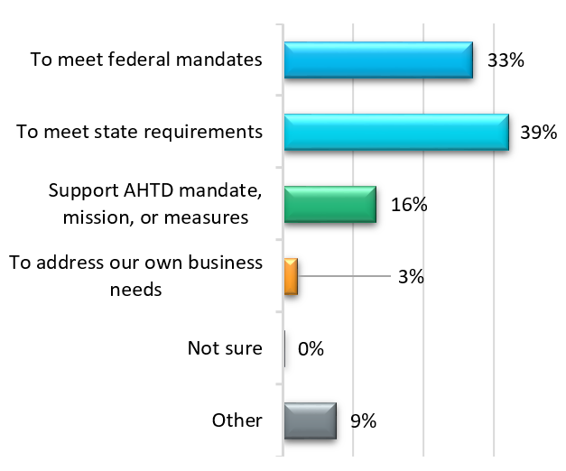
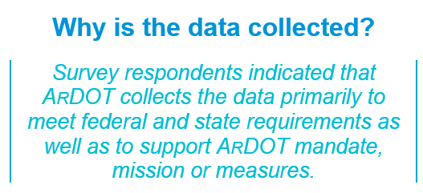
ASSESS CURRENT STATE - SURVEY SAYS!

Slide 13
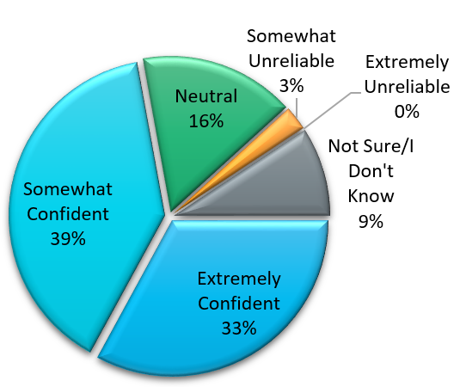
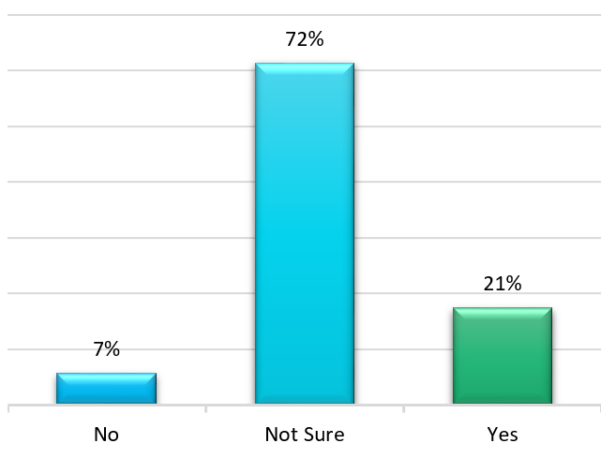
ASSESS CURRENT STATE - SURVEY SAYS!

Slide 14
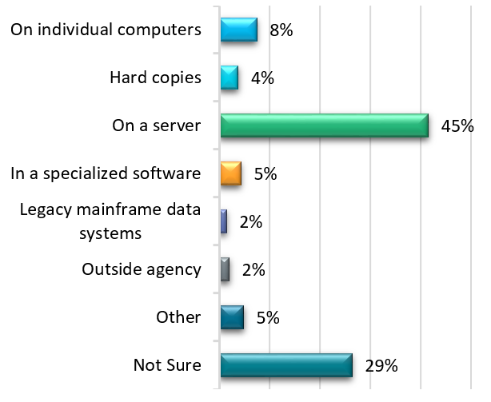
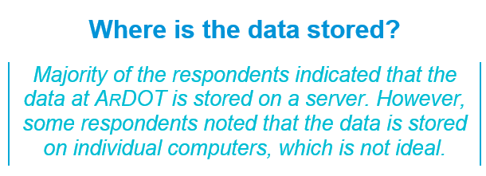
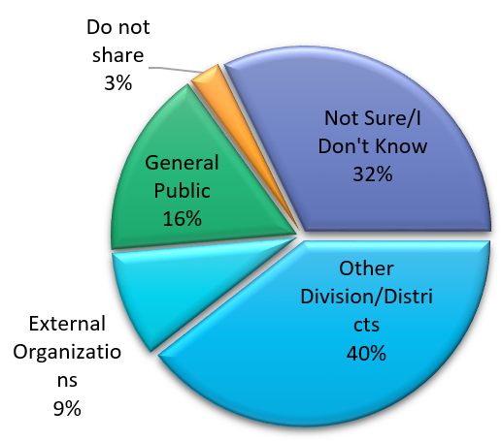
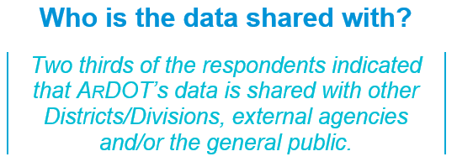
ASSESS CURRENT STATE - SURVEY SAYS!

Slide 15
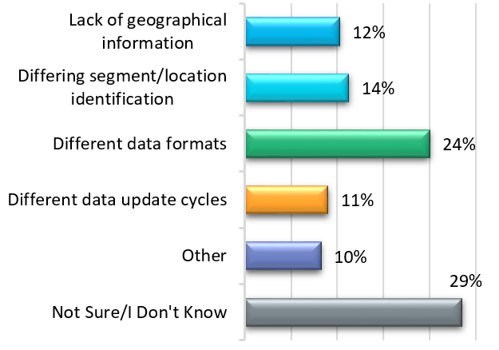
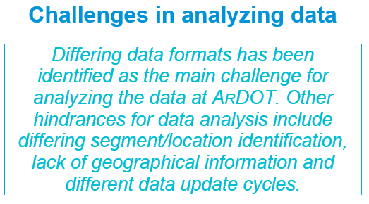
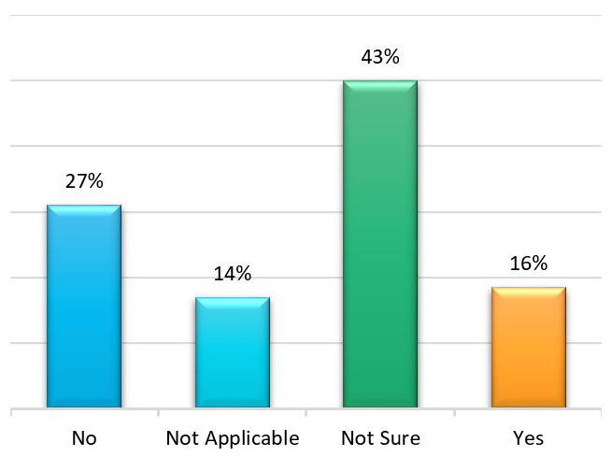
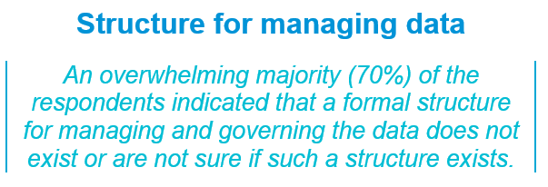
ASSESS CURRENT STATE - SURVEY SAYS!

Slide 16
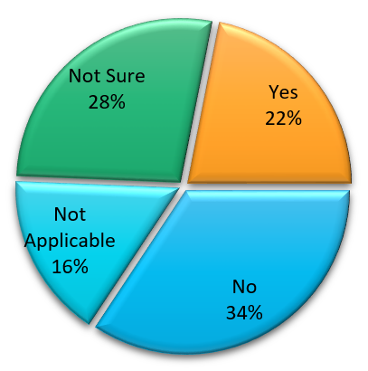
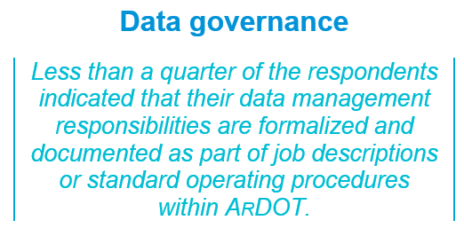
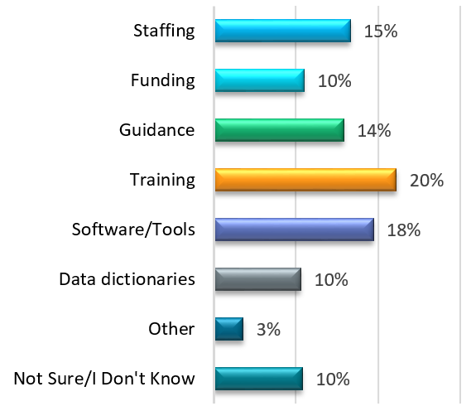
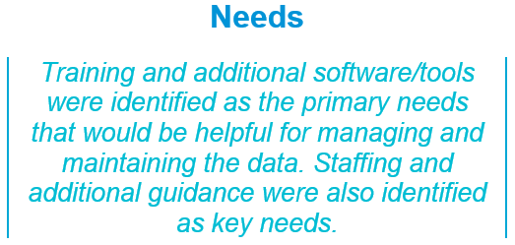
ASSESS CURRENT STATE - SURVEY SAYS!

Slide 17
ASSESS CURRENT STATE - SURVEY SAYS!
Typed Responses

Slide 18
ASSESS CURRENT STATE - SURVEY SAYS!
Typed Responses

Slide 19
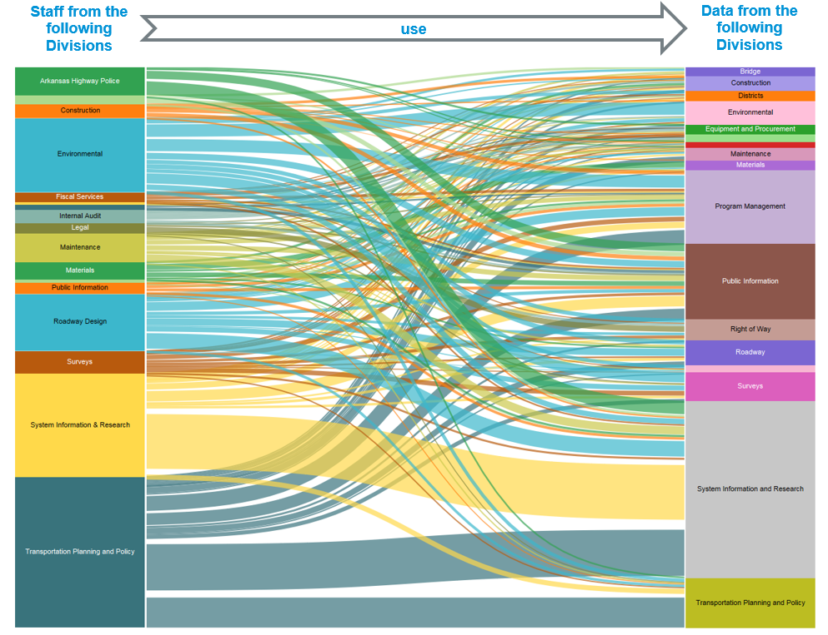
ASSESS CURRENT STATE - SURVEY SAYS!

Slide 20
POLICIES AND DOCUMENTATION
DATA DICTIONARY
DATA CATALOG
List/Definition of attributes
Type Field (Text, Number, etc…)
Number characters allowed
Information expected/required
Temporality and limitations
Lists All Available Data Sets
Where is the Data
Clarify Owners
Information to understand the purpose and how to use the data
METADATA

Slide 21
POLICIES AND DOCUMENTATION
METADATA
IS A
LOVE NOTE
TO THE FUTURE

Slide 22
POLICIES AND DOCUMENTATION
CURRENT METADATA?

Slide 23
ADVERTISING DATA - TRAINING DATA USERS
How should we advertise our data?
Word of mouth
Articles in both print and digital media
Internal news releases/e-mail blasts
Posters, brochures, and fliers
Outreach and presentations to others such as “Lunch n’ Learns”, Identified Stakeholder meetings, etc…
Special events and that ARDOT holds
Are we effective communicators when it comes to data?

Slide 24
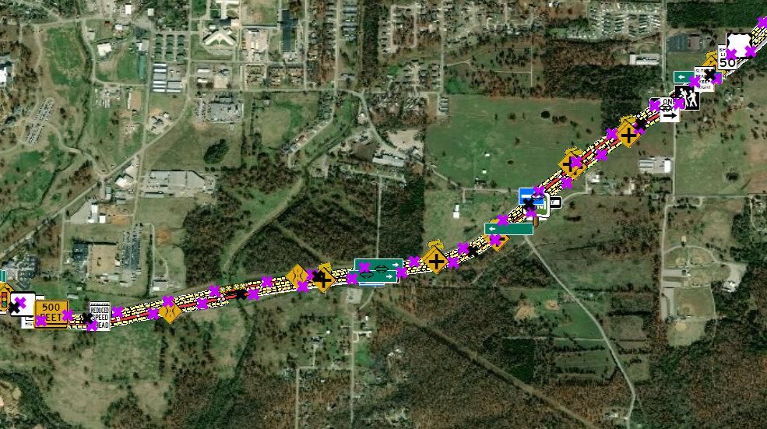
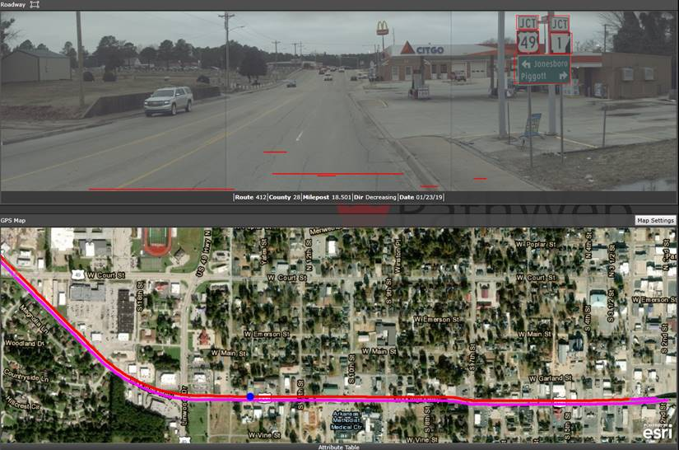
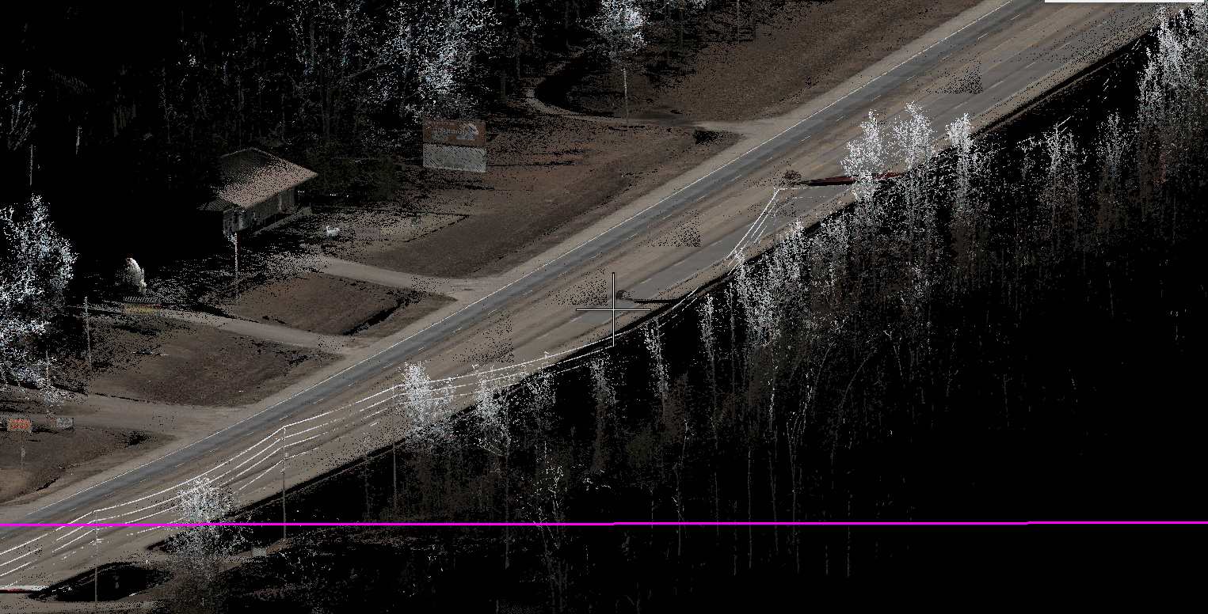
ADVERTISING DATA - TRAINING DATA USERS
EXAMPLE

Slide 25
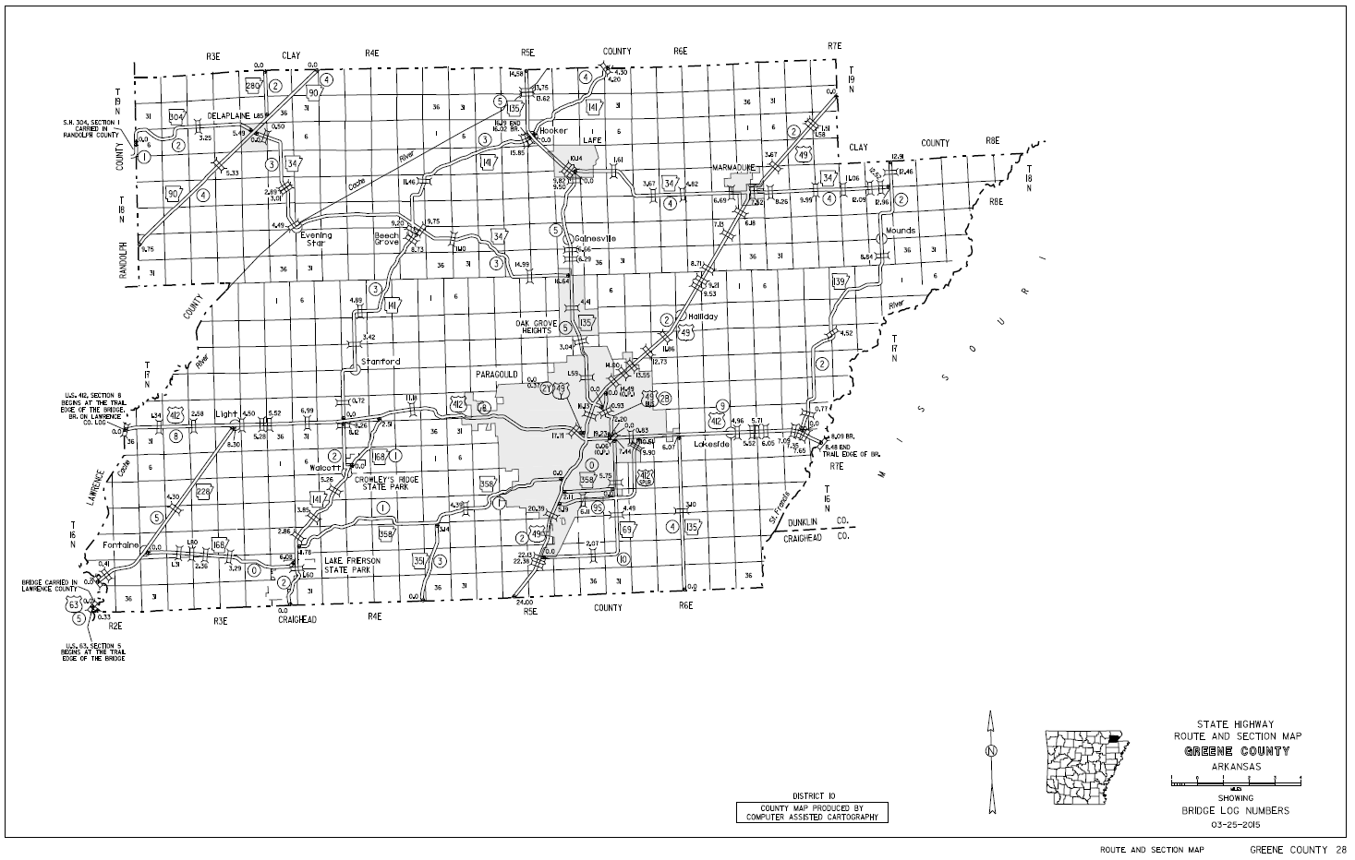
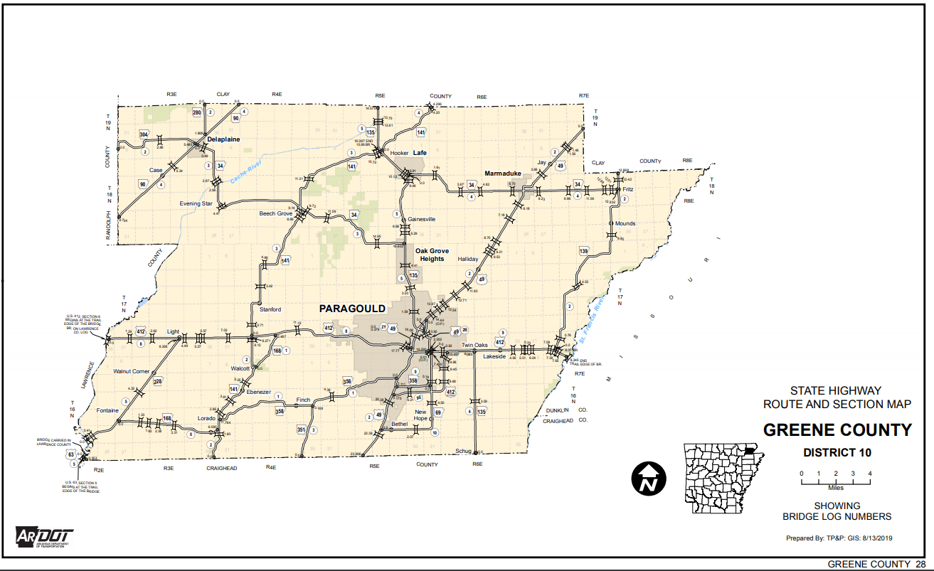
ADVERTISING DATA - TRAINING DATA USERS
EXAMPLE

Slide 26
ADVERTISING DATA - TRAINING DATA USERS
Owners
Secondary Users
Primary Users
Collectors
IT

Slide 27
IMPLEMENTING DATA GOVERNANCE
ALL WE HAVE TO DO IS…

Slide 28
IMPLEMENTING DATA GOVERNANCE
Identify champions.
Use DBP results to establish strong, sustainable vision for data governance and obtain executive support.
Budget for implementation of the Safety and Mobility DBP and dedicate staff resources.
Improve quality of safety data systems by implementing system improvements related to data collection, data access, data quality and validation, and documentation.
Improve quality of mobility data systems by implementing system improvements related to data collection, data access, data quality and validation, and documentation.
Formally adopt core principles for data and information management and incorporate them into governance policies, standards, and processes.
Develop and adopt a data governance charter and governance roles and responsibilities for ARDOT’s Data Governance Committee.
Institutionalize data governance roles and responsibilities by incorporating them into staff job descriptions and job performance review criteria.
Develop and adopt a Data Governance Playbook that documents the State’s policies, standards, roles, and responsibilities for managing data programs under the authority of the Data Governance Program.
Develop data dictionary and business rules for interpreting ARDOT’s data systems.
Develop a Data Catalog that identifies ARDOT’s data systems, system stewards, data elements and attributes, data linkages, data access policies, and system documentation.
Train staff on data policies, procedures, processes, and tools for safety and mobility data analysis and reporting.
Train external stakeholders such as MPOs and local agencies on accessing and using safety and mobility data and tools as appropriate.
Require training of new staff receiving access to data. Create online training that can be delivered on-demand. Require testing of concepts and certification of staff upon completion.
Track progress in implementing the improvements identified in the Safety and Mobility DBP.
Establish and assess performance metrics to monitor success.
Report on progress to the Data Governance Committee and senior management.
Improve data sharing, coordination, and knowledge transfer of safety and mobility data by implementing institutional improvements related to transmission, sharing and exchange of data, cost management solutions, and knowledge management as identified in improvement plan.

Slide 29
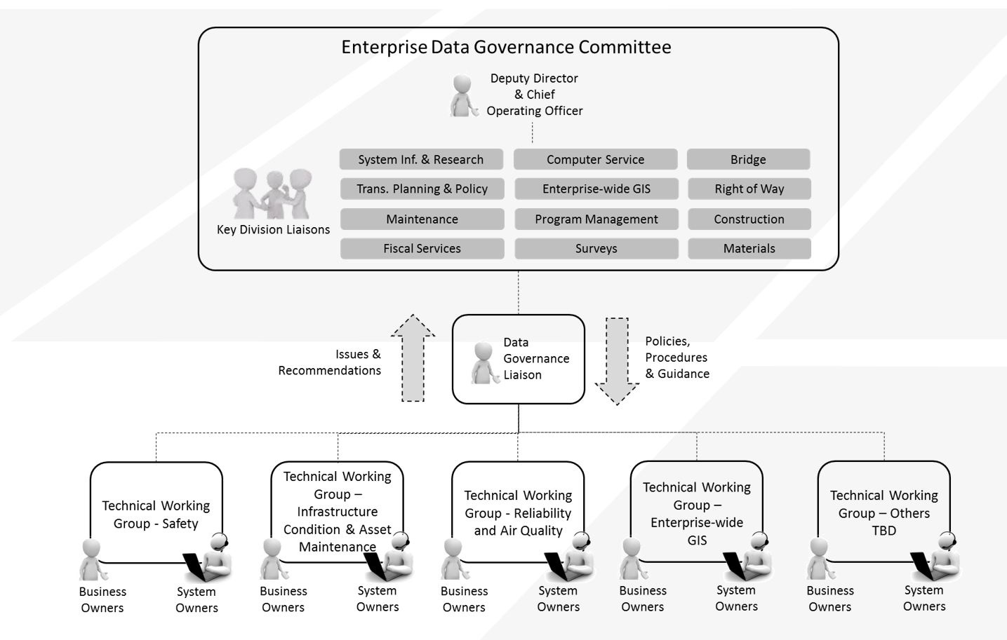
IMPLEMENTING DATA GOVERNANCE
PROPOSED DATA GOVERNANCE MODEL

Slide 30
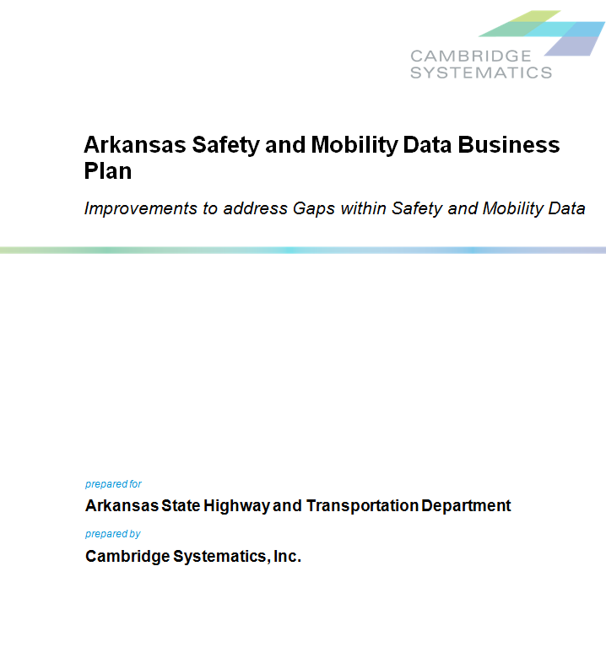
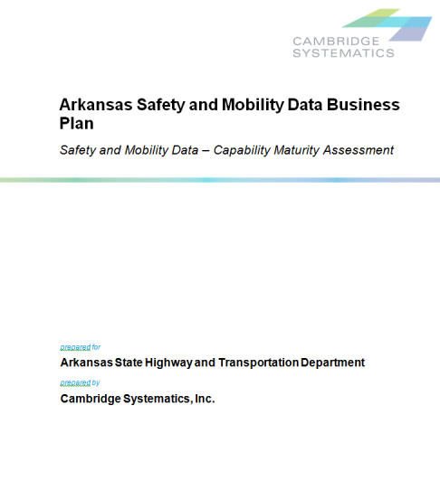
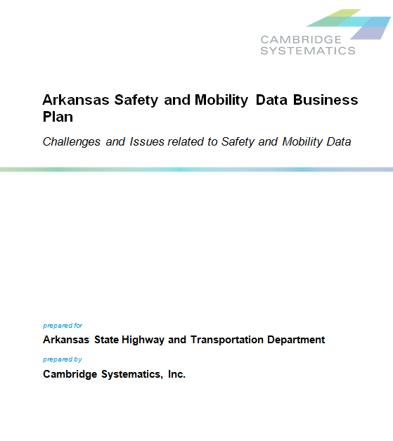
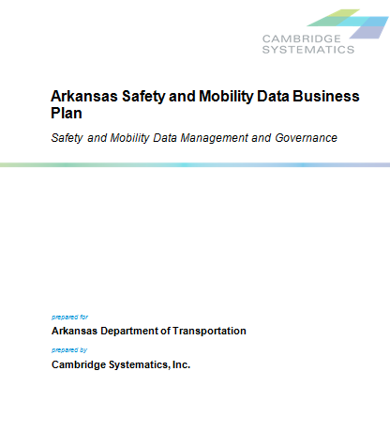
NOW AVAILABLE

Slide 31
THANK YOU

